Slide 1




Introduction to Causal Inference for Software Engineering
A 90-minute hands-on tutorial
Julien Siebert · Julian Frattini · Hans-Martin Heyn · Roberto Pietrantuono

Slide 2
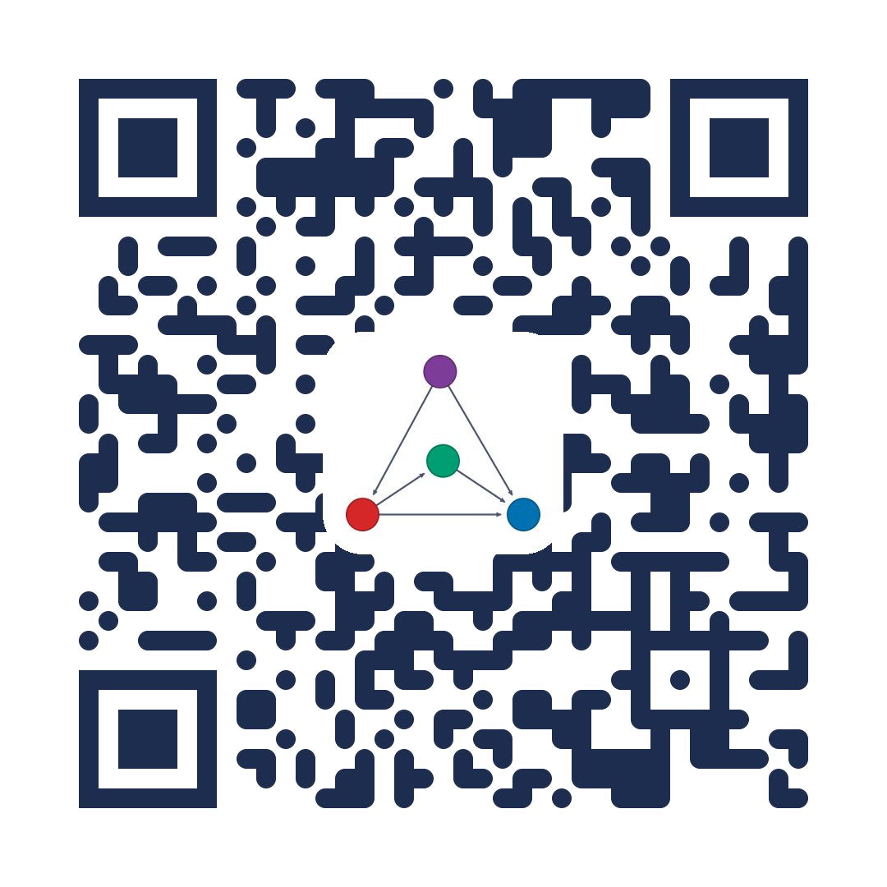
Welcome to a tutorial on causal inference in SE
This tutorial is for researchers and practitioners who like to explore what causal inferences can offer for Software Engineering.
We do not require prior knowledge in statistics or mathematics. We will work mostly with graphical methods for causal inference.
Lecture materials, exercises, and reading suggestions are available at: https://github.com/martinheyn/CI4SE_Tutorial

Slide 3
PART 1 · OVERVIEW
Motivation and modeling, grounded in SE
1
Motivation — Why SE questions are causal, not just associational
2
Modeling — Causal graphs, confounders, and Pearl's process
3
Examples — Worked recipes for testing and fault localization
4
The road ahead — Where causal software engineering is heading
2

Slide 4
MOTIVATION · HUMAN–MACHINE CO-ENGINEERING
How machines have supported software engineers
1
2
3
4
Scaffolding
Organizing & structuring work
IDEs · version control · linting
Support automation
Formalized methods for tasks
Coverage testing · static analysis
Support decision
Learn from data; predict
Estimation · fault prediction · RCA
Support reasoning
Explain, hypothesize, plan
What-if · counterfactuals · RCA
3

Slide 5
MOTIVATION · BEYOND CORRELATION
Example 1: Same improvement — but what caused it?
Scenario A microservice team ships a new client-side retry policy to cut tail latency. Within an hour, latency drops.
3
4
Correlation view
AIOps attributes the drop to the deploy: “the change fixed latency.”
Plan: replicate the pattern on other services.
Causal view (CSE)
Estimate the effect of do(X) net of confounders Z, with uncertainty — then act on it:
→ Strong, robust effect: proceed / widen the canary
→ Real but modest: proceed, but stop tuning
→ Tied to one factor: target the likely cause, apply that fix elsewhere
But autoscaling increased replicas in a downstream dependency and a traffic shift moved requests away from a “hot” region: both can reduce queueing delays. So is the improvement due to the new retry policy, to autoscaling, traffic shift or their interaction? When repeating under different conditions, latency regresses → incident.
4

Slide 6
MOTIVATION · BEYOND CORRELATION
Example 2: Blaming the wrong cause
A shuttle brakes too late. A correlation-based tool finds late braking (Y) co-occurs with high-res camera mode (X) — and blames the camera.
But a confounder drives both: higher speed (Z) triggers the camera switch and shrinks the braking margin.
Z
speed
X
Y
A causal model answers what-if questions:
“What if we adjust the speed threshold?”
camera
late brake
Adjust for Z to remove the spurious X–Y link.
5

Slide 7
MOTIVATION
Software engineering is increasingly data-driven
Machine learning and LLMs now support nearly every SE activity — prediction, generation, recommendation across the lifecycle. This data-driven paradigm scales one human ability: pattern recognition.
What it does well
Learns associations from large datasets; automates and amplifies inductive reasoning.
Where it stops
Stays at rung 1 — association. It predicts from what it has seen, not what would happen if we act.
6

Slide 8
MOTIVATION
The questions SE asks are causal, not associational
Observing
P(Y | X = x)
“What outcome when we happen to see X = x?”
Good for prediction. Blind to confounding.
Intervening
P(Y | do(X = x))
“What outcome if we actively set X = x?”
Behind testing, debugging, tuning, policy change.
Most worthwhile SE questions are causal — but answers can't come from data alone (Pearl).
7

Slide 9
MOTIVATION
Climbing the ladder of causation — in SE terms
1
Association · Seeing
“What if I see…?” Past tests & observations correlate with failures.
2
Intervention · Doing
“What if I do…?” Set an input and predict the effect — what-if analysis, test selection.
3
Counterfactual · Imagining
“What if I had done…?” Would the failure have occurred otherwise? Root-cause & debugging.
8

Slide 10
MODELING CAUSAL EFFECTS
A causal graph makes assumptions explicit
Nodes = variables. Directed links = direct causal effects. A DAG encodes hypotheses we can reason about and test.
Z
Confounder — common cause of T and Y — induces spurious correlation; adjust for it
confounder
Mediator — lies on T → M → Y — carries part of the effect
T
Y
Collider — common effect — conditioning on it opens a spurious path
treatment
outcome
Z biases the T → Y estimate unless we adjust for it.
9

Slide 11
MODELING CAUSAL EFFECTS
The process: from assumptions to validated effects
1
2
3
4
→
→
→
Model
State assumptions as a causal graph
Identify
Can the effect be estimated from data?
Estimate
Compute the effect (regression, ML, …)
Refute
Try to falsify the estimate
The graph is a collaborative reasoning partner — inspectable, contestable, and refinable by engineers.
10

Slide 12
EXAMPLES FROM SE RESEARCH
Three domains where causal graphs are taking hold
Testing
Choose inputs that expose failures — what-if reasoning over a model of the system under test.
Fault localization
Trace a failure to its cause; separate the culprit from mere correlates.
Requirements engineering
Causal models as requirements engineering activity
For each: first the big picture, then a concrete, repeatable recipe.
11

Slide 13
EXAMPLES · TESTING — WHERE WE ARE
Testing is naturally causal
Choosing a test input implicitly predicts an outcome under a hypothetical condition — a what-if question.
Test generation is planning, not prediction: what output if we submitted this input? Causal models let testers reason, not guess.
1
Guessing → Tester intuition/expertise
“what might fail?”
2
Correlation → ML on past tests/data
“what correlates with failure?”
3
Causation → Interventions
“what input causes it to fail?”
12

Slide 14
EXAMPLES · TESTING — EXAMPLE 1
A recipe for Causal Test Generation Generating tests by intervening on a causal model
Goal. Pick inputs most likely to expose a failure instead of sampling blindly.
input A
1
Model — over inputs, internal factors, and the outcome
factor
outcome
input B
2
Learn — fit from a few runs or domain knowledge
3
Intervene — query do(input = x) to predict the outcome
P(Y | X=x) vs P(Y | do(X=x))
Observing vs. setting — only do(·) reveals which inputs cause the failure.
4
Select — run only configs predicted to breach the requirement
Reusable wherever inputs map to a measurable requirement.
14

Slide 15
EXAMPLE 1 · IN PRACTICE
Concretely: testing a self-driving car in a simulator
Setup. A simulator with ~16 scene inputs and a safety requirement: staying in lane (DCL).
A counterfactual question
Observed: rain, curved, FPS=30 → safe
Counterfactual: had FPS been 20?
Learned causal model (excerpt)
weather
road
naïve : P(DCL>thr | FPS=20) = 0.85
causal: P(DCL>thr | do(FPS=20)) = 0.55
speed
FPS
DCL
Road confounds FPS → DCL — adjusting for it makes do(FPS) ≠ P(DCL | FPS). That 0.85→0.55 gap is the causal payoff.
Concrete example after: Giamattei et al., Causality-driven Testing of Autonomous Driving Systems (ACM TOSEM 33(3), 2024).
15

Slide 16
EXAMPLES · TESTING — EXAMPLE 2
The same recipe for non-functional testing
Testing is also about planning what-if scenarios.
Keep the Example 1 recipe; just change the outcome variable:
Functional
outcome = requirement violated
Performance
outcome = latency past threshold
“Which workloads push latency past the threshold?”
Fairness, energy…
outcome = any quality metric
16

Slide 17
EXAMPLE 2 · IN PRACTICE
Concretely: which workload breaches the SLO?
Setup. A microservice under load. The model links workload & resources to p99 latency.
The what-if query
P(latency > SLO | do(rate=high, replicas=2))
Causal model over workload & resources
intervention
p99
verdict
req rate
rate ↑, replicas = 2
1.8× SLO
breach
CPU
p99 lat
rate ↑, replicas = 4
0.9× SLO
ok
replicas
async call
0.7× SLO
ok
Concrete example after: Giamattei et al., Identifying Performance Issues in Microservices (AST 2024).
17

Slide 18
EXAMPLES · FAULT LOCALIZATION — WHERE WE ARE
Fault localization: the leading application
It maps onto the chain from a fault to a failure. Two flavours dominate:
~50%
of surveyed papers
Causal reasoning is seen as a way to explain why an event happened.
Debugging — Locate the faulty statement and the fix — statistical FL, program repair.
Root cause analysis — Find the culprit component in a running system — esp. microservices & cloud.
True causal inference — e.g. counterfactual RCA — is still uncommon; most work learns the structure, then ranks.
*References to Julien and mine surveys
18

Slide 19
EXAMPLES · FAULT LOCALIZATION — EXAMPLE 3
Tracing a failure to its true cause
In a system of interacting components, a failure propagates. A causal model separates the real culprit from components that merely correlate with the symptom.
The counterfactual query
P( failᵢ | do( compₖ = fail ) )
“If component k fails, which others fail too?”
Interventions trace the chain without injecting real faults.
Propagated — An inner failure cascades; the edge component gets blamed.
Masked — A symptom is hidden downstream; black-box checks pass.
comp k
→
comp j
→
symptom
Inspired by: Johnson, Brun & Meliou, Causal testing: understanding defects' root causes (ICSE 2020).
20

Slide 20
EXAMPLE 3 · IN PRACTICE
Concretely: tracing a failure across services
Setup. A benchmark of ~40 services. A failure in an inner service shows up at the edge.
do(Auth = fail) — propagation traced
Order ✕
.92
Auth ✕
Front ✓
The intervention
P(fail(Pay), fail(Order) | do(Auth = fail))
Pay ✕
.88
Synthetic result: Auth=fail propagates to Order (0.92) & Payment (0.88); front-end masked.
✕ fails under do(·) ✓ stays up (failure hidden)
Concrete example after microservice RCA literature; cf. Wu et al. (2021). (TO MAKE EXPLICIT)
21

Slide 21
EXAMPLES · FAULT LOCALIZATION — THE GENERAL RECIPE
A repeatable recipe for causal RCA
Whatever the system, the same three moves turn telemetry into an explainable root cause.
1 · Build the graph
Components & runtime variables as nodes; edges from architecture or causal discovery.
2 · Reason on it
Trace propagation with do(comp = fail); ask counterfactuals about alternatives.
3 · Adjust & explain
Control for confounders; return an inspectable causal chain.
→
→
Why it transfers: independent of the domain — microservices, cloud, cyber-physical, ML pipelines. Swap variables, keep the reasoning.
25

Slide 22
USING CAUSAL INFERENCE · THE PROCESS
How a practitioner actually uses causal inference
The examples so far were end results. Underneath them is one repeatable two-step process: build a causal model, then query it — with humans in the loop throughout.
1
Step 1 — Learning
Construct a causal model — from a specification, from data, or both
2
Step 2 — Inference
Query the model — what-if (proactive) & counterfactual (retroactive)
→
The causal model is a collaborative reasoning partner, not a black-box oracle — engineers can inspect, challenge, and override it.
26

Slide 23
THE PROCESS · STEP 1
Building the causal model (learning)
Three sources, often combined — the model encodes what we know and what we measure.
Specification
Experts declare cause-effect relations - which links must hold, which are forbidden. An inspectable record of assumptions; LLMs can suggest variables.
Discovery
Causal-discovery algorithms extract structure from data - observational or experimental, structured or text. Engineers validate & revise.
Fitting
However the structure is obtained (via Specification, Discovery or Hybrid) data parameterize it – e.g., structural equations (SCM) or conditional distributions (CBN).
Domain expertise, assumptions-based
Observations/data, evidene-based
Validation: if observations contradict a specified relation, revisit whether the assumption is wrong - or the data simply insufficient.
Pietrantuono, Giamattei & Russo, Reasoning Beyond Prediction: From Data-Driven to Causal Software Engineering, CACM (to appear in Dec 2026) – https://arxiv...
27

Slide 24
THE PROCESS · STEP 2
Querying the model (inference)
With a model in hand, engineers ask two kinds of question - and can refute the answers.
Proactive - what-if
do(X = x): predict the effect of an action before taking it.
Design exploration, test generation, performance tuning.
Retroactive - counterfactual
would the failure have occurred had X been different?
Root-cause analysis, debugging, corrective maintenance.
Estimate with uncertainty, then refute: effect estimates come with confidence intervals and are checked by refutation tests
Pietrantuono, Giamattei & Russo, Reasoning Beyond Prediction: From Data-Driven to Causal Software Engineering, CACM (to appear in Dec 2026) – https://arxiv...
28

Slide 25
REFERENCES
Sources & further reading – TO INTEGRATE
Framework & roadmap
Fault localization & RCA
Pietrantuono, Giamattei, Russo. Reasoning Beyond Prediction: From Data-Driven to Causal
Software Engineering to appear in CACM, 2026, https://arxiv.org/abs/2606.27960
- Johnson, Brun, Meliou. Causal testing: understanding defects' root causes. ICSE 2020.
- Causal Software Engineering: A Vision and Roadmap. arXiv:2605.02454.
- Wu, Tordsson, Elmroth, Kao. Causal Inference Techniques for Microservice Performance. 2021.
- Giamattei et al. Causal reasoning in SQA: a systematic review. IST 178 (2025) 107599.
- PyWhy / DoWhy - GCM root-cause analysis example (pywhy.org).
Testing
Requirements engineering
- Giamattei et al. Causality-driven Testing of Autonomous Driving Systems. ACM TOSEM 33(3), 2024.
- Heyn et al. Causal models as a Requirements Engineering activity (arc-fault study).
- Giamattei et al. Identifying Performance Issues in Microservices through Causal Reasoning. AST 2024.
- Ahmad et al. RE for AI systems: a systematic mapping. IST 158 (2023) 107176.
- Mascia et al. Microservices performance testing (causality-guided / LLM), 2025.
- D'Amour et al. Underspecification in modern ML. JMLR 23 (2022).
- Mitchell et al. Algorithmic fairness: choices, assumptions, definitions. 2021.
- Clark et al. Metamorphic Testing with Causal Graphs. ICST 2023.
- Foster et al. Causal inference for systems with hidden/interacting variables. EASE 2025.
Validity & caveats
- Hulse, Eisty, Menzies. Shaky structures: causal graphs in software analytics. EMSE 30 (2025).
44

